Slide 1

MIPS Assembly
Computer Organization

Slide 2


1. Intro
Review
What is Assembly?
MIPS Addressing Modes
Memory Operation
Processor Overview
MIPS Assembly Language diving deeper

Slide 3
What is Assembly?
Assembly is the lowest level language that humans routinely deal with
Simple, regular instructions
Building blocks of C & other languages
One-to-one mapping to machine language
...sort of

Slide 4
About Assembly
Writing in Assembly is usually slower than writing in other languages
Assembly is not portable
It is specific to a processor (family)
It will make you a better software architect
Optimized Assembly can be wicked fast

Slide 5
Assembly and Machine Code
Machine Code can be decompiled to Assembly
Converting Assembly to Machine Code and back to Assembly loses relatively little information
Code formatted for direct execution by a CPU

Slide 6
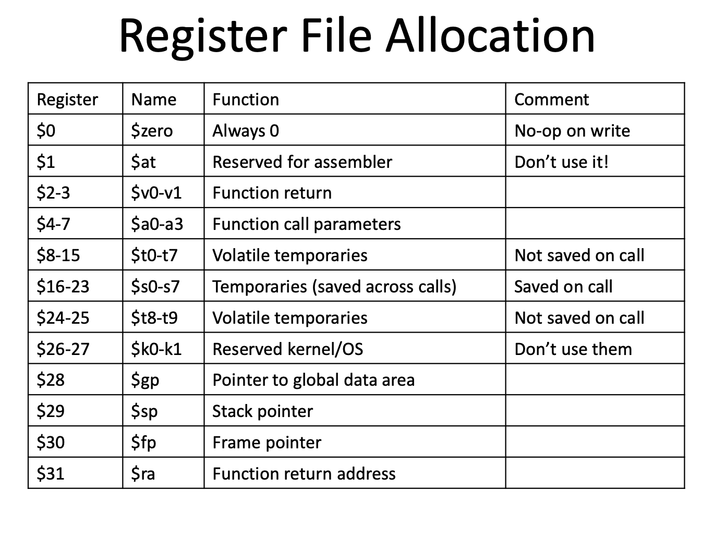

Slide 7
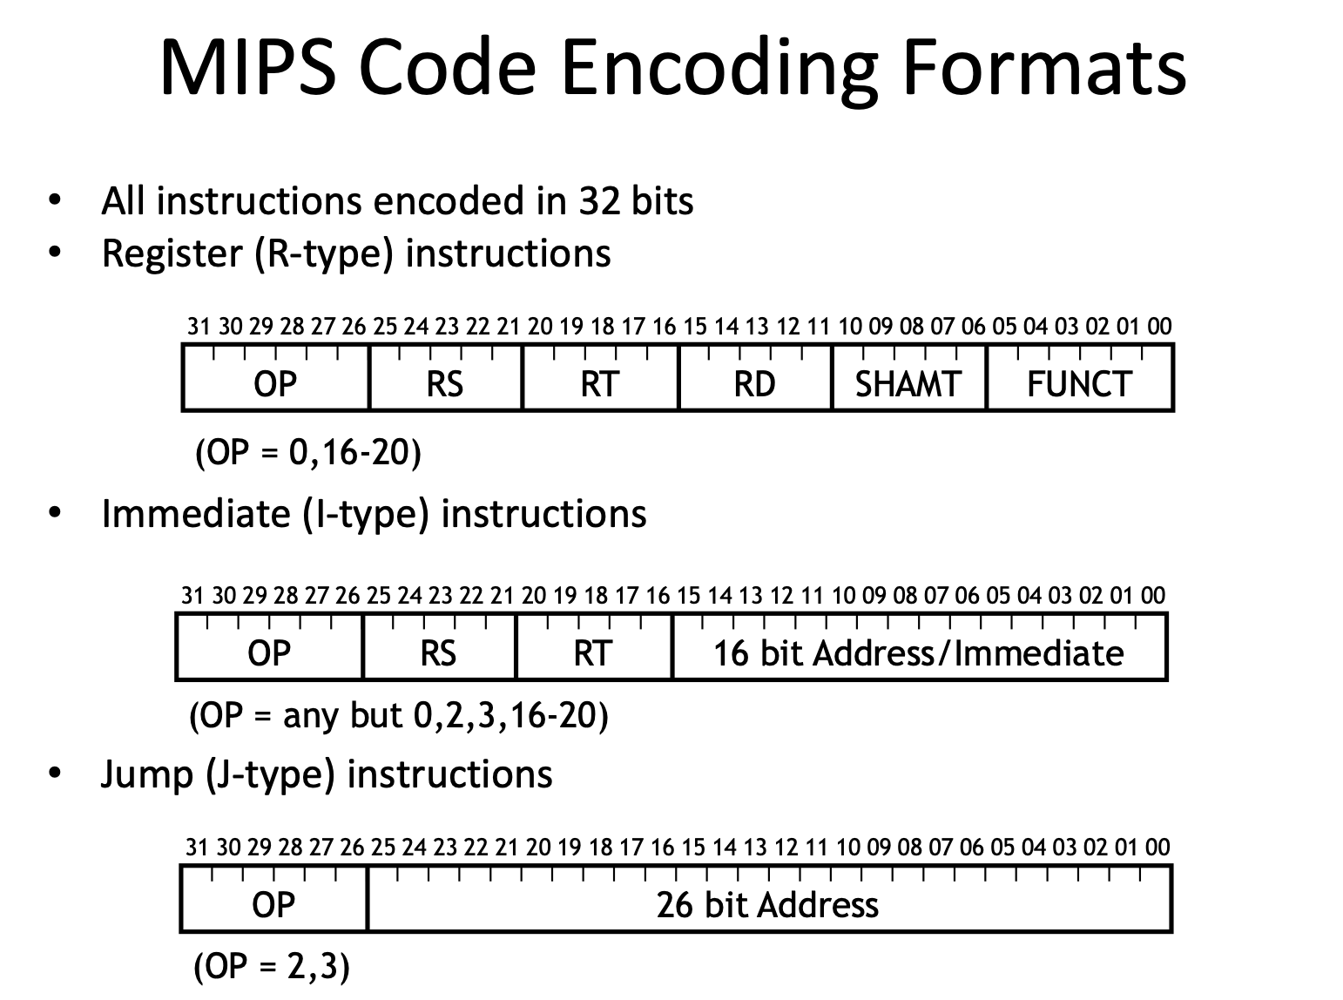

Slide 8
MIPS Addressing Modes
Addressing modes is how we specify an operand or a memory address.
Register addressing
Immediate addressing
Base addressing
PC-relative addressing
Indirect addressing
Direct addressing (almost)

Slide 9
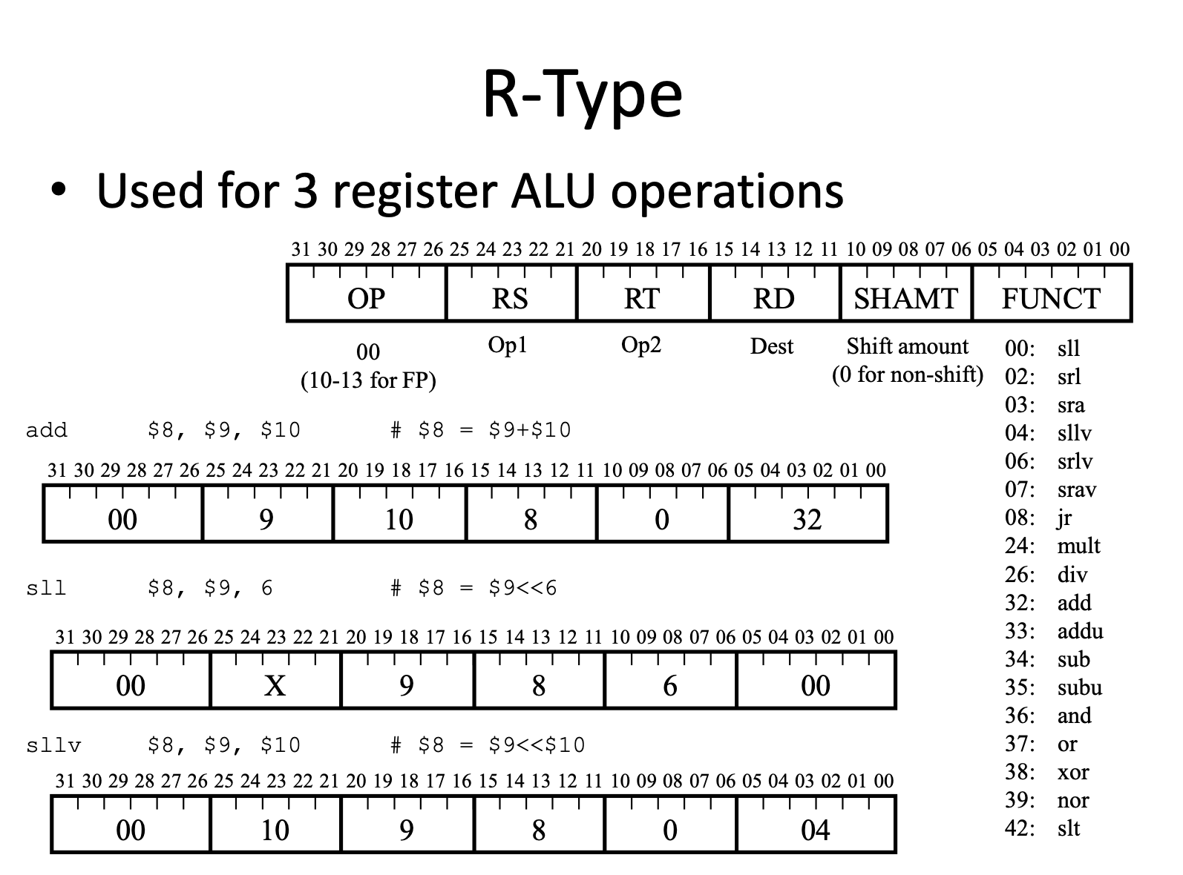

Slide 10
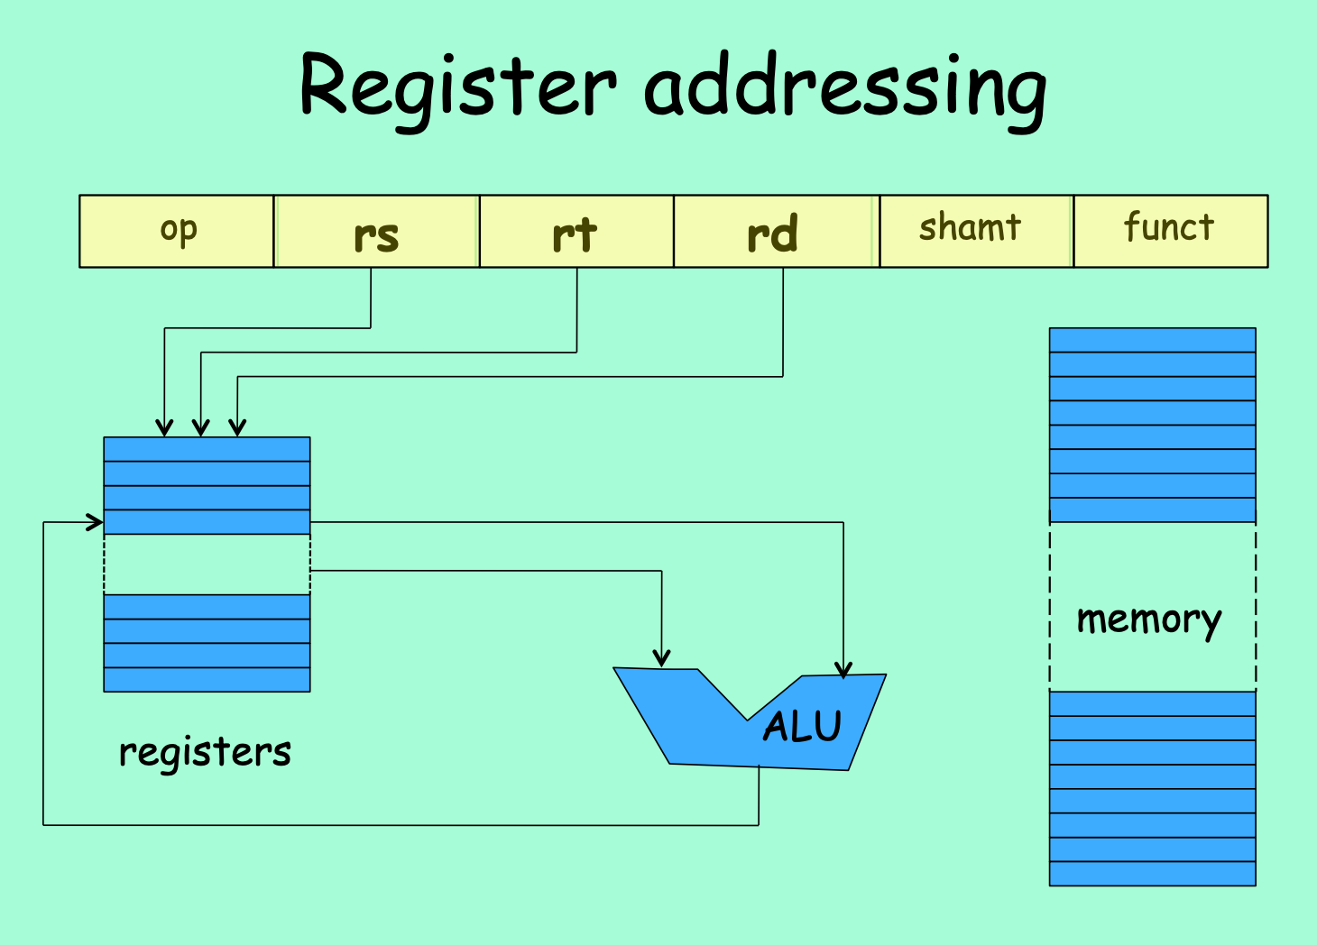
Notes:
add $3, $4, $5

Slide 11
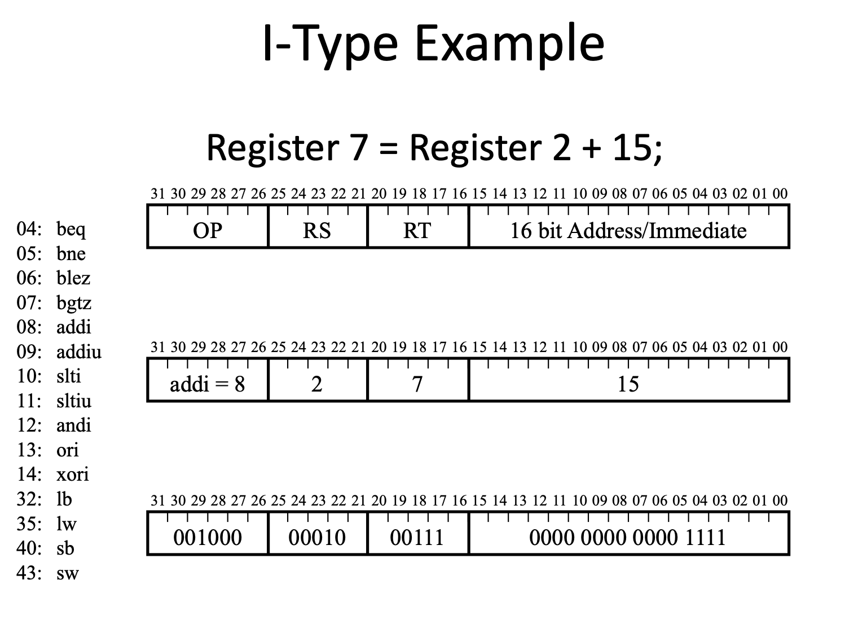

Slide 12
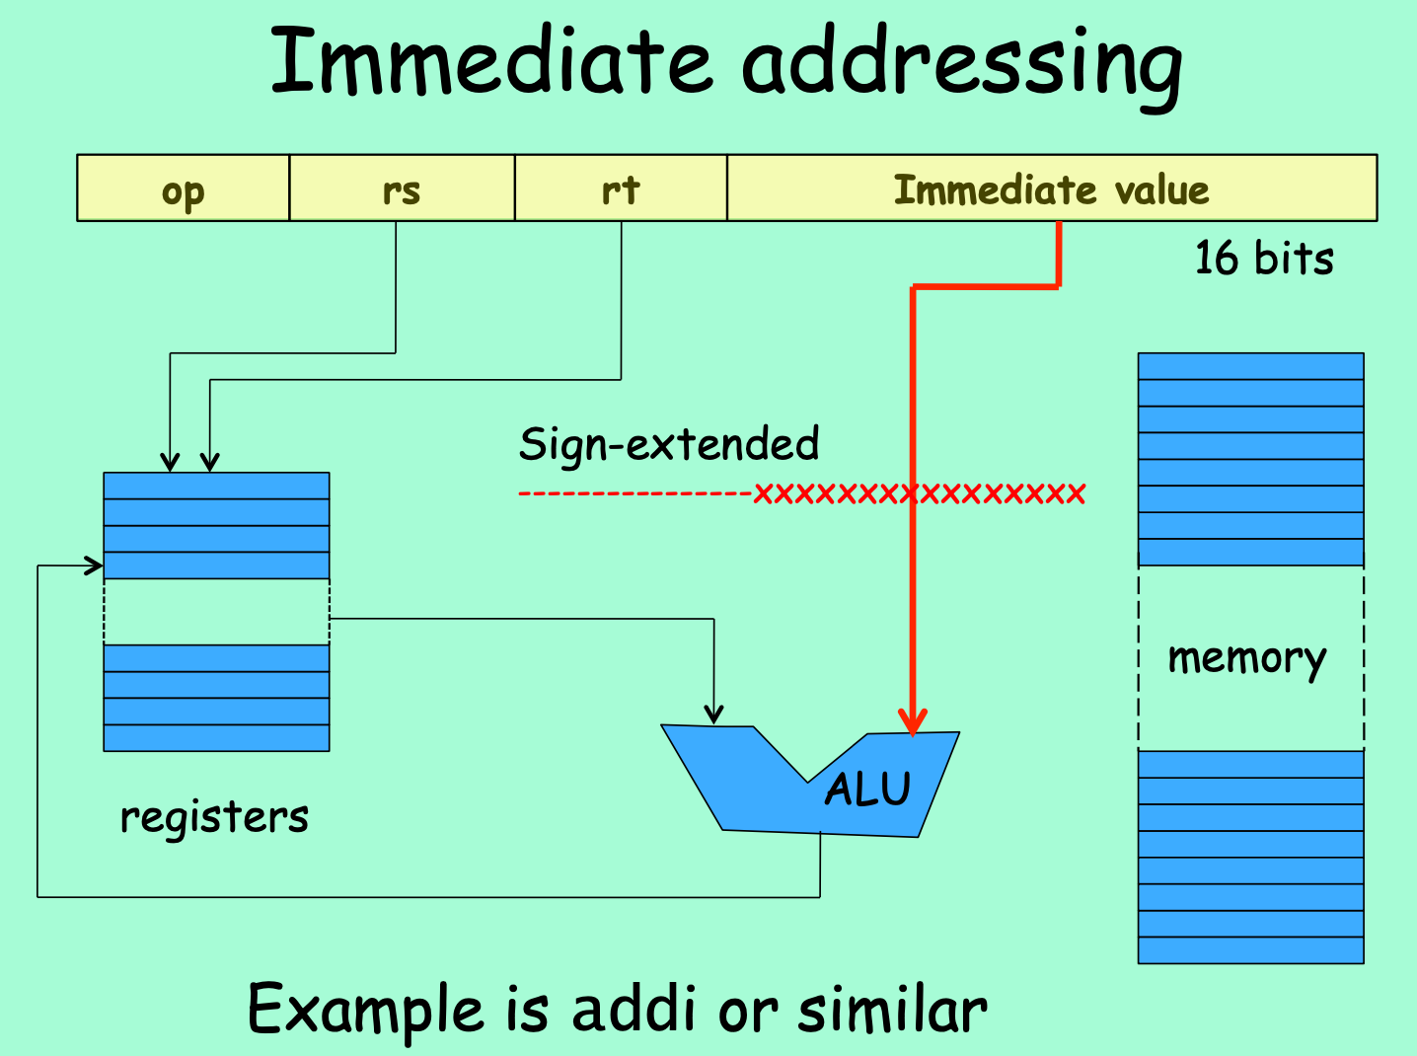
Notes:
The operand is embedded inside the encoded instruction
addi $t0, $t1, 3

Slide 13
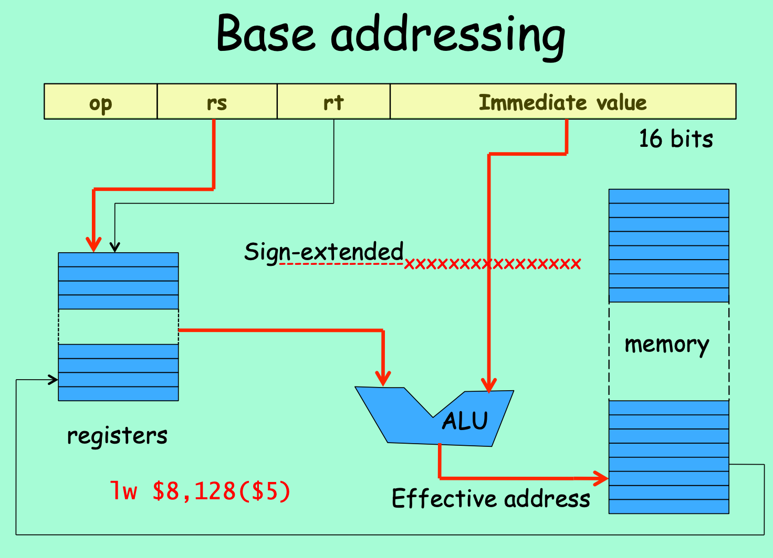

Slide 14
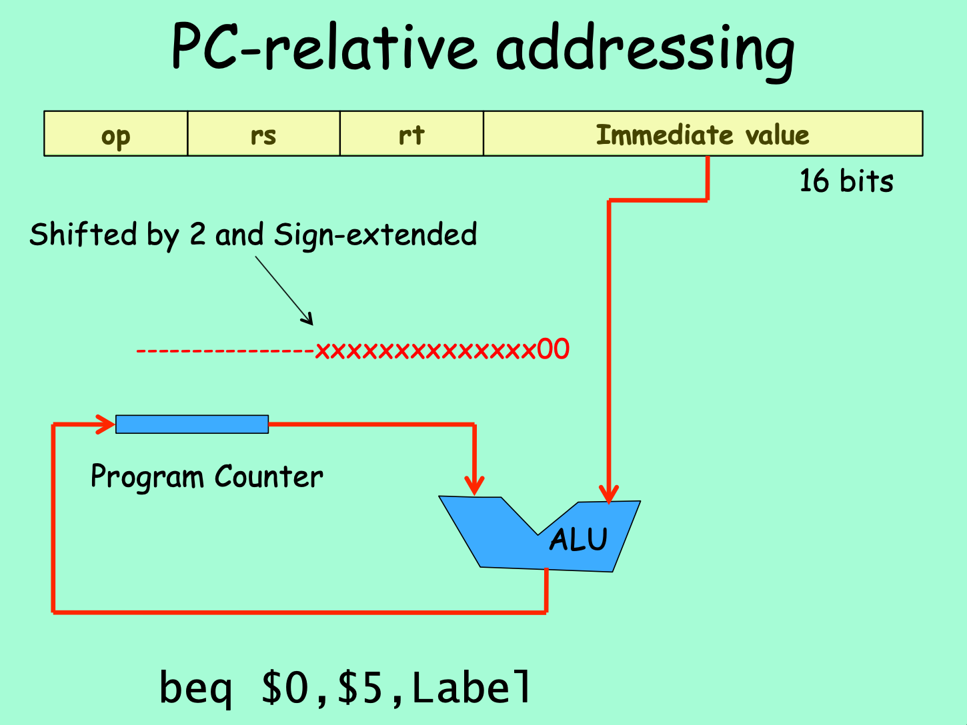

Slide 15
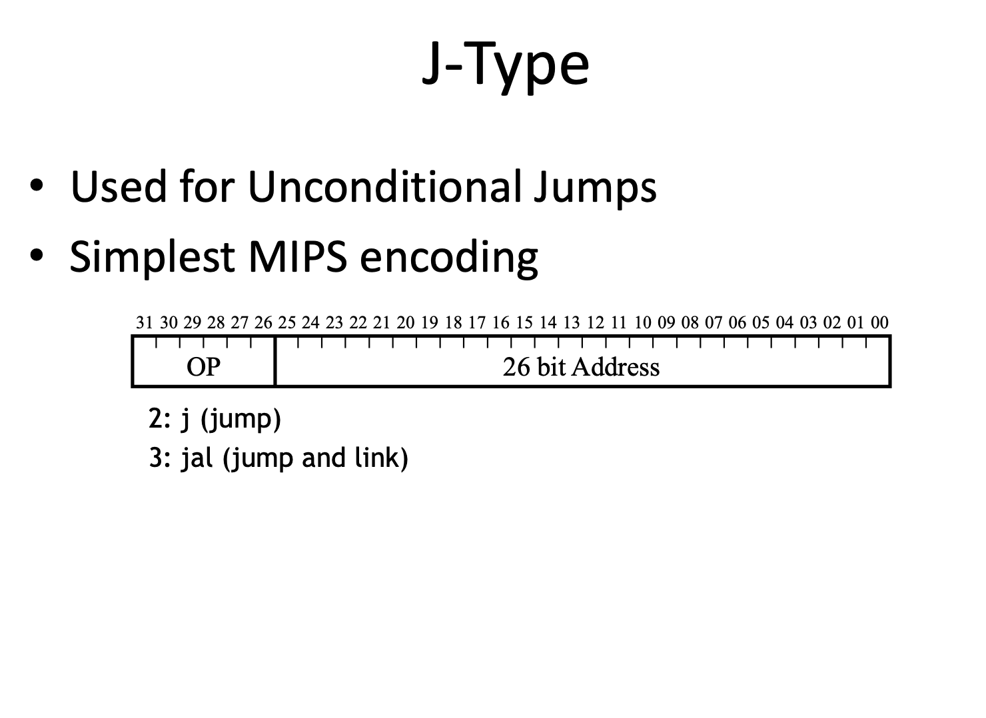

Slide 16
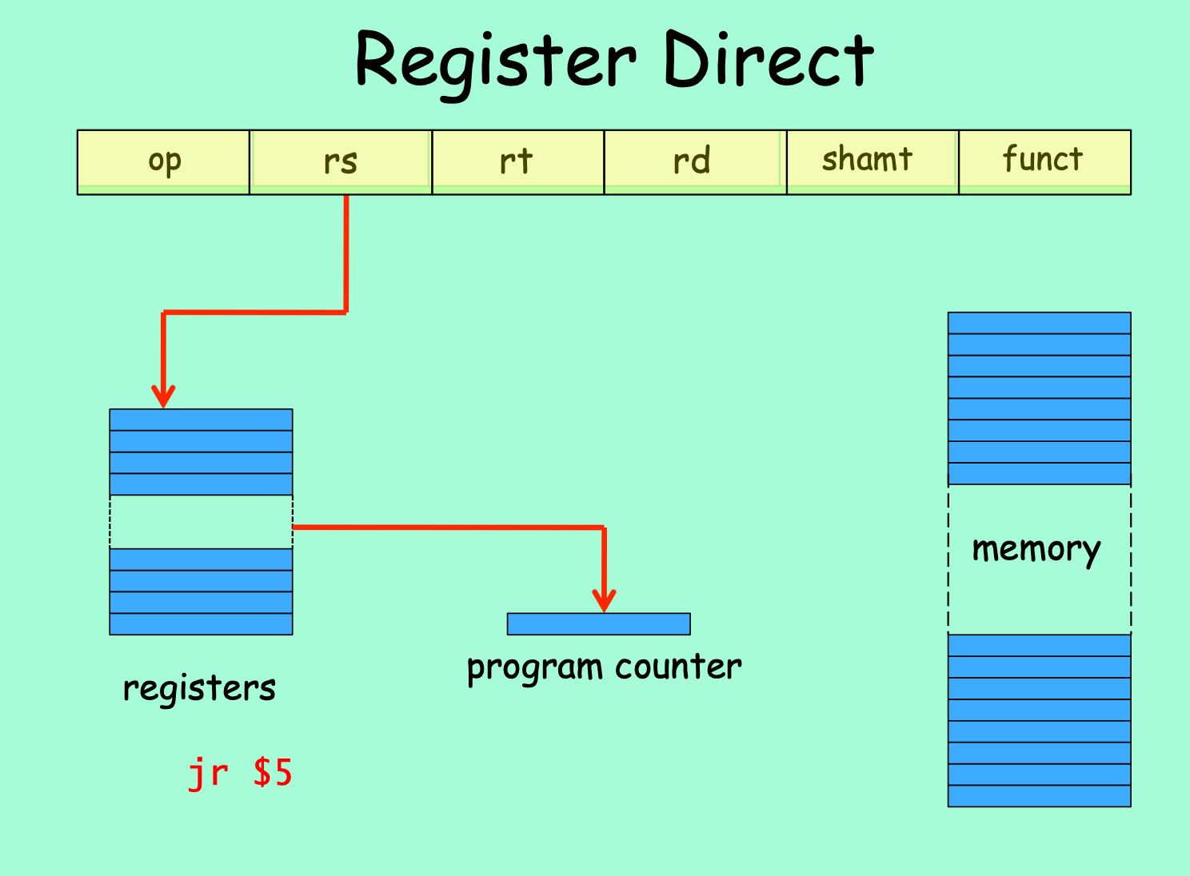
Notes:
Register Direct Addressing: the value the (memory) effective address is in a register. Also, called “Indirect Addressing”
Special case of base addressing where offset is 0
Use with the jump register instructions (jr, jalr)
Example: jr $31

Slide 17
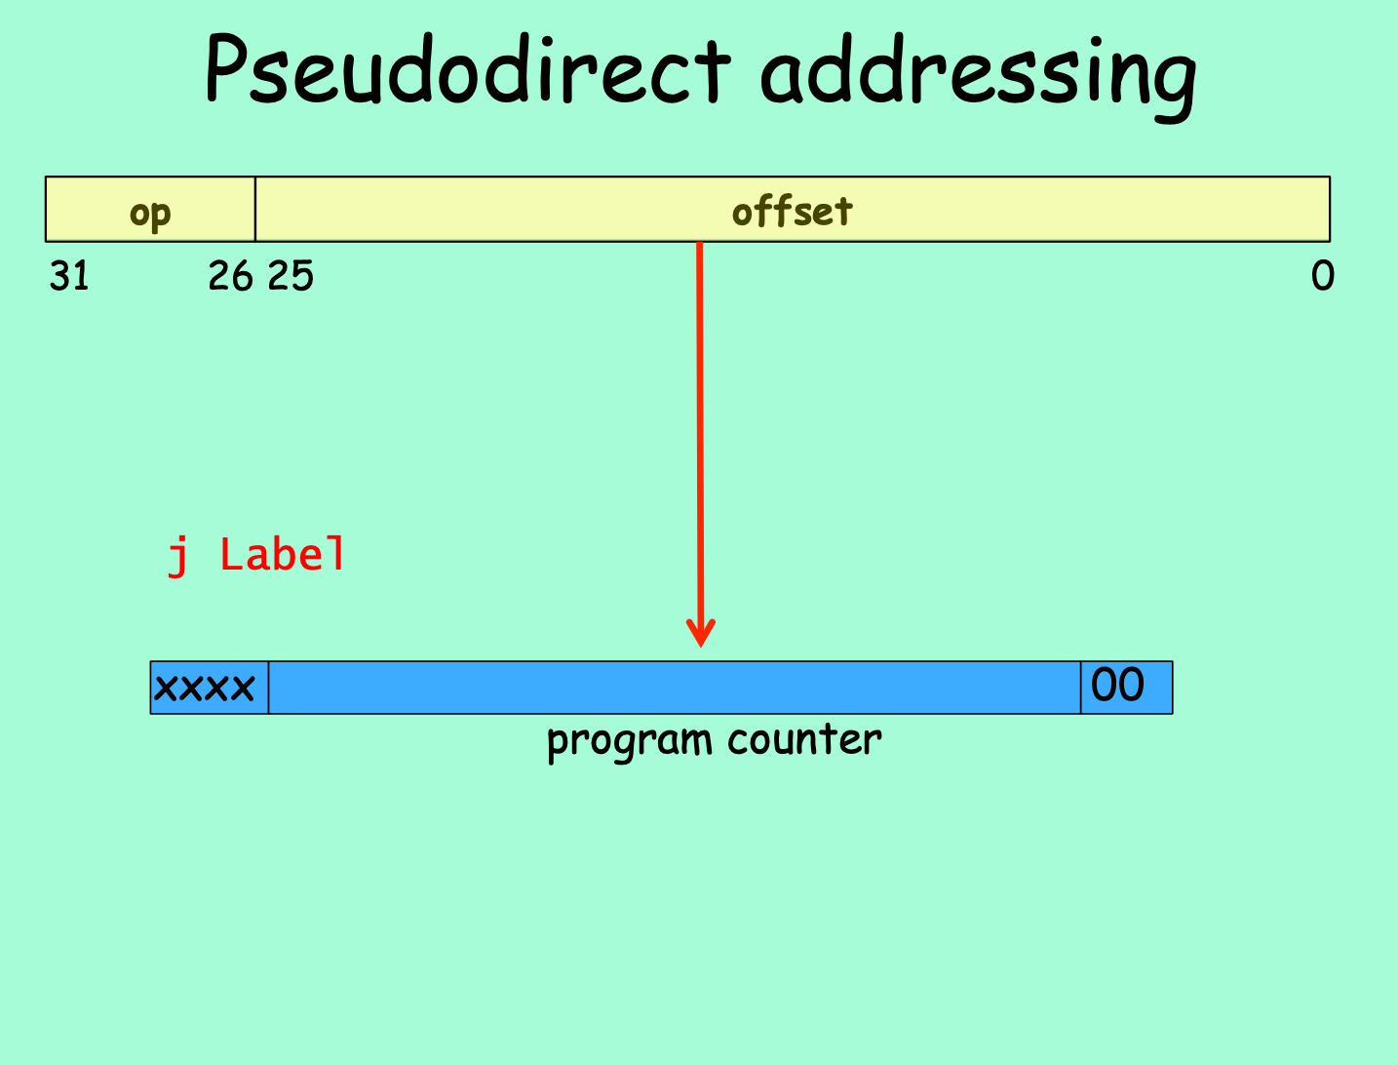
Notes:
Direct addressing: the address is “the immediate” 32 bit address cannot be embedded in a 32-bit instruction
Pseudo-Direct addressing:26 bits of the address is embedded as the immediate, and is used as the instruction offset within the current 256MB (64MWord) region defined by the MS 4 bits of the PC. Example j Label

Slide 18
In Summary
Addressing mode is not Instruction type
Addressing mode is how an address (memory or register) is determined
Instruction type is how the instruction is put together
Example: addi, beq and lw are all I-types instructions. But…
addi uses immediate addressing mode (and register)
beq uses pc-relative addressing (and register)
lw uses base addressing (and register)

Slide 19
In Summary - MIPS Addressing Mode
Register: a source or destination operand is specified as the content of one of the registers $0-$31 except reserved
Immediate: a numeric value embedded in the instruction is the actual operand
PC-Relative: a data or instruction memory location is specified as an offset relative to the incremented PC
Base: a data or instruction memory location is specified as a signed offset from a register
Register-Direct: the value the effective address is in a register
Pseudo-Direct: the memory address is (mostly) embedded in the instruction

Slide 20
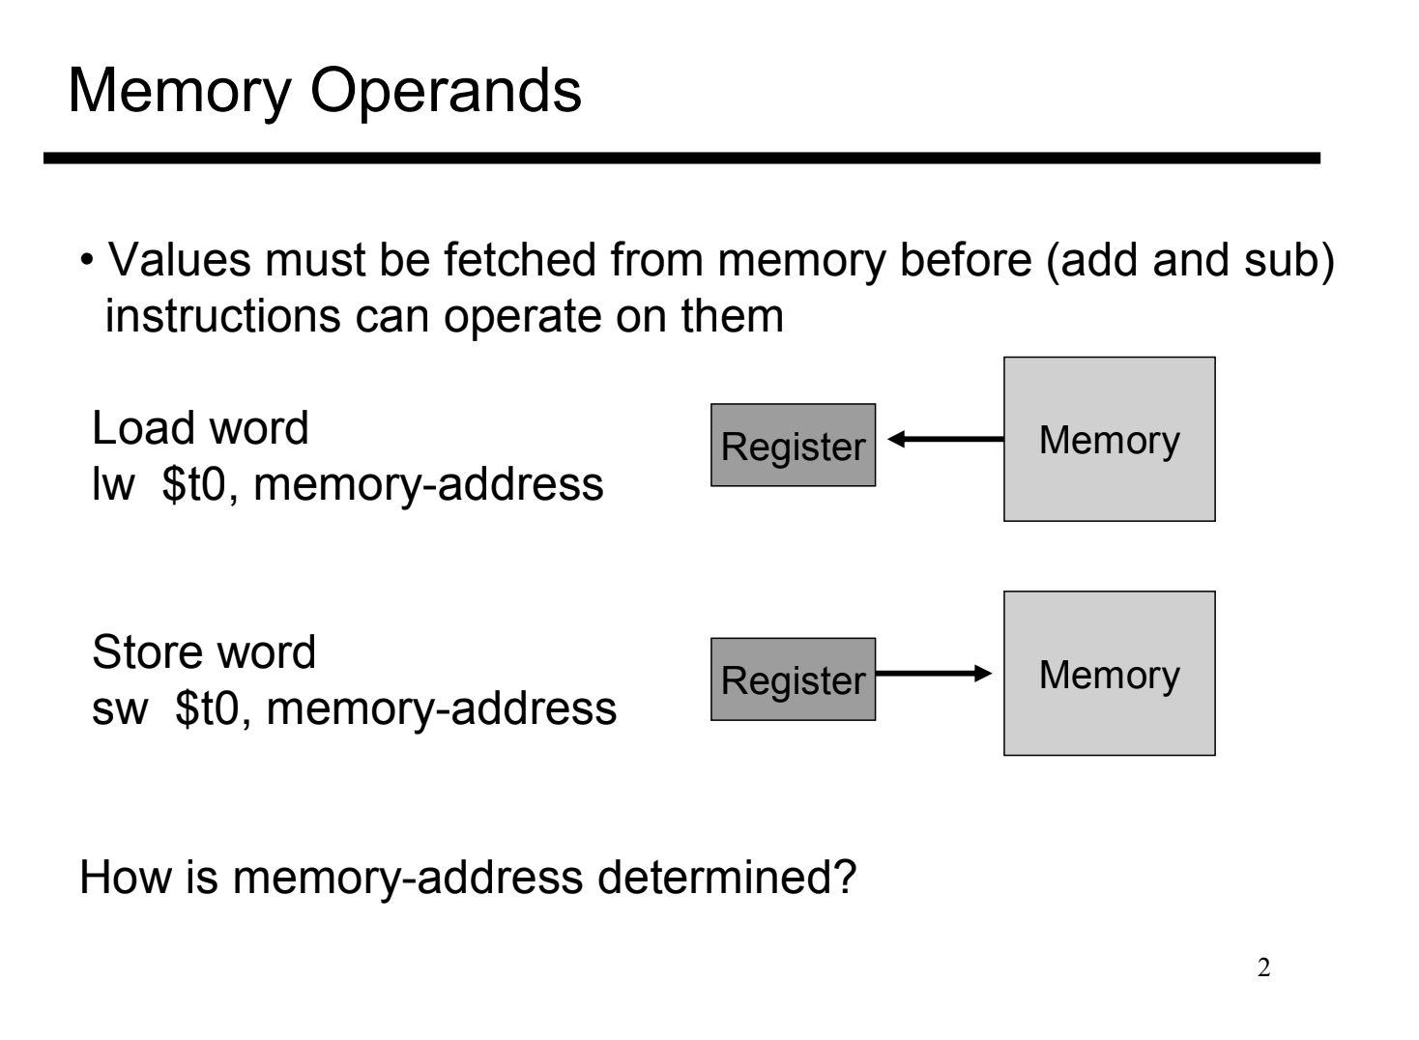

Slide 21
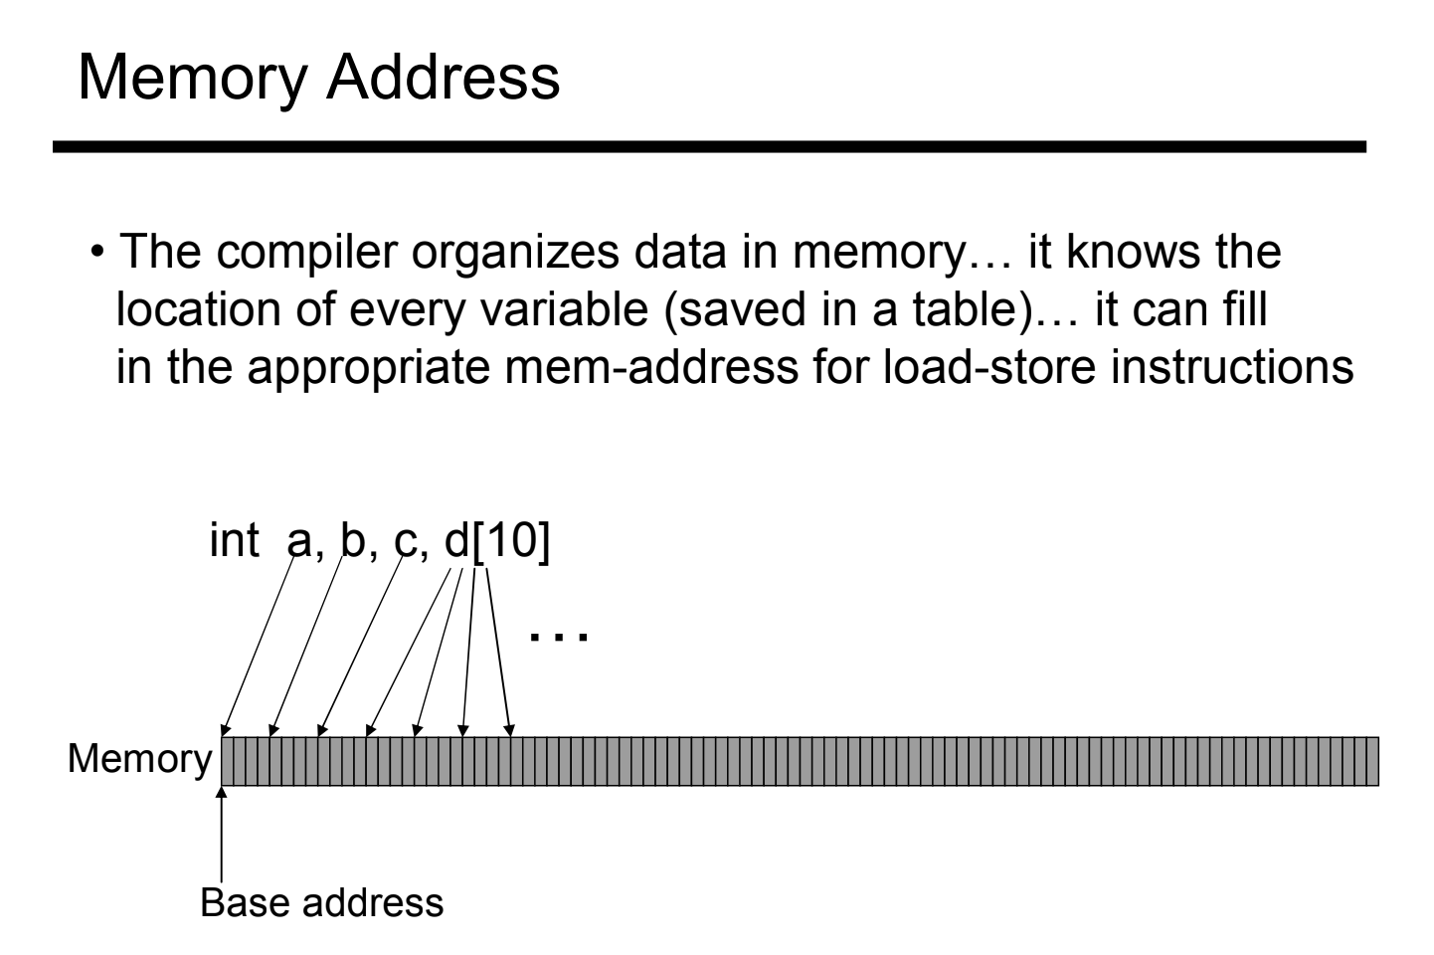

Slide 22
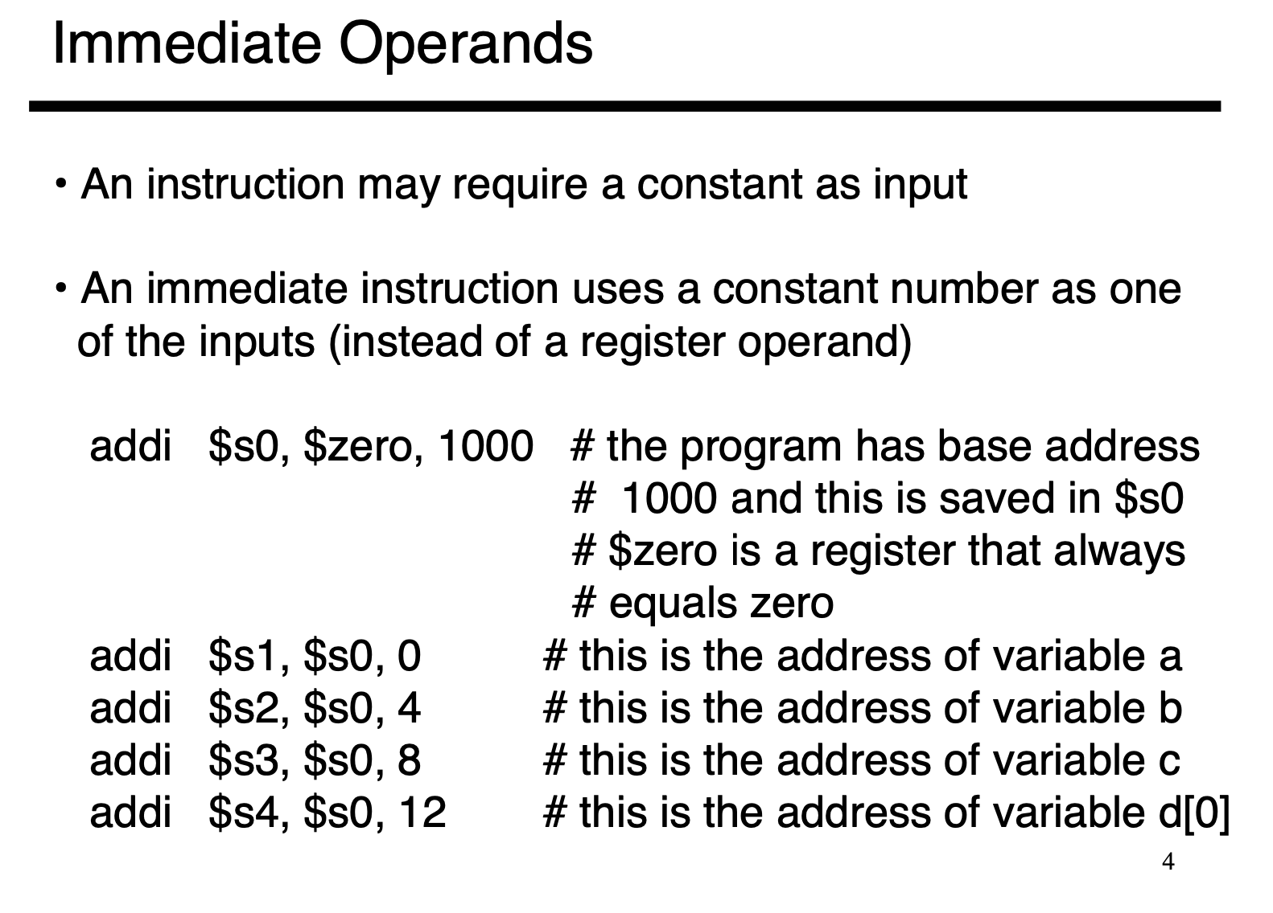

Slide 23
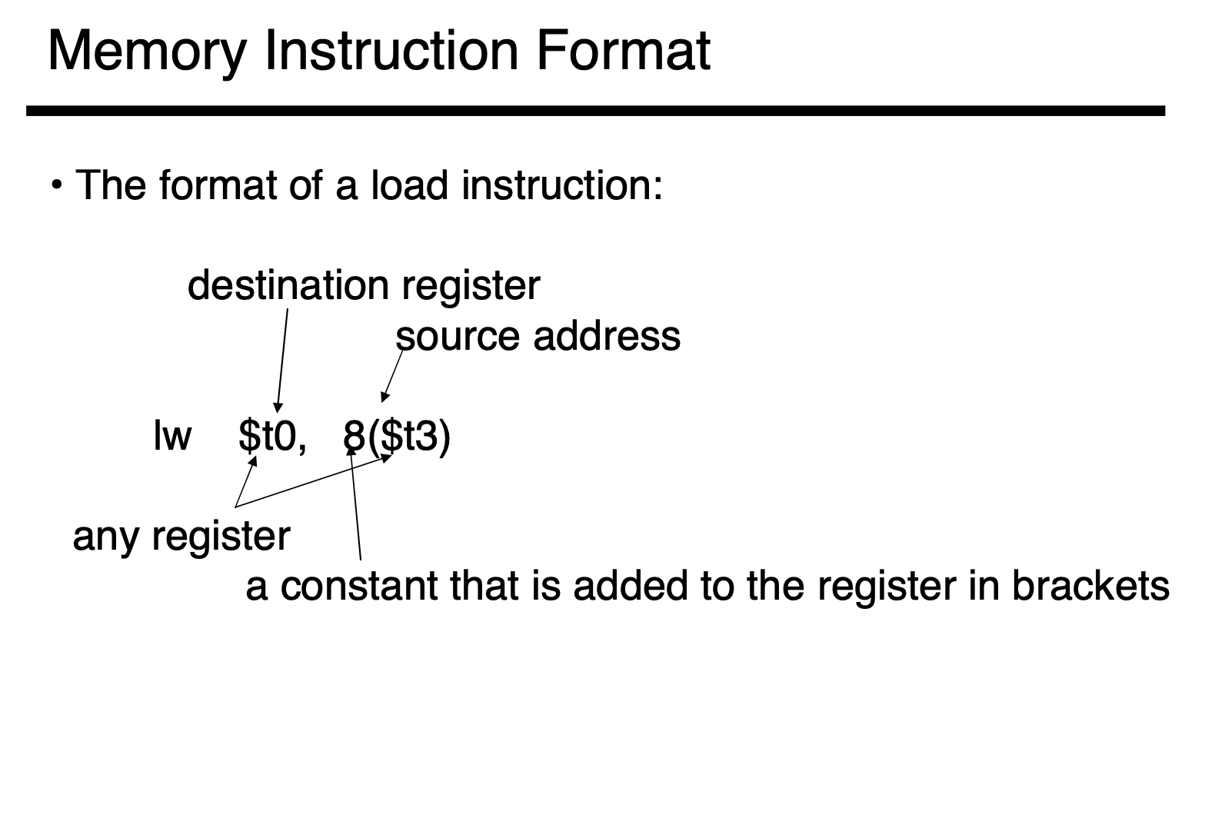

Slide 24
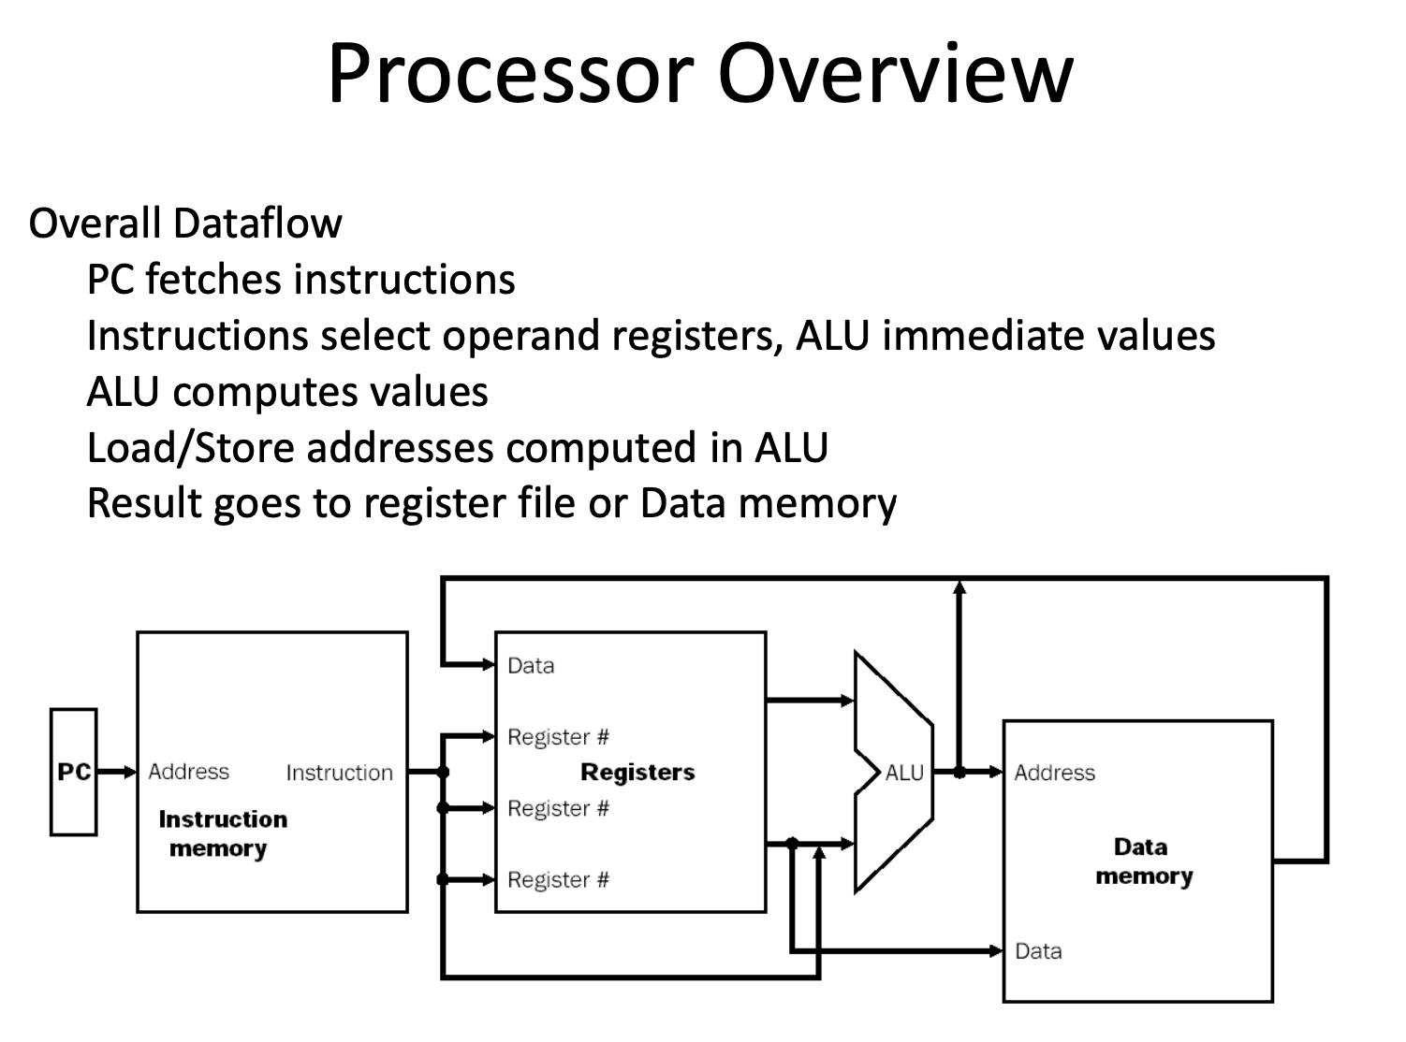

Slide 25
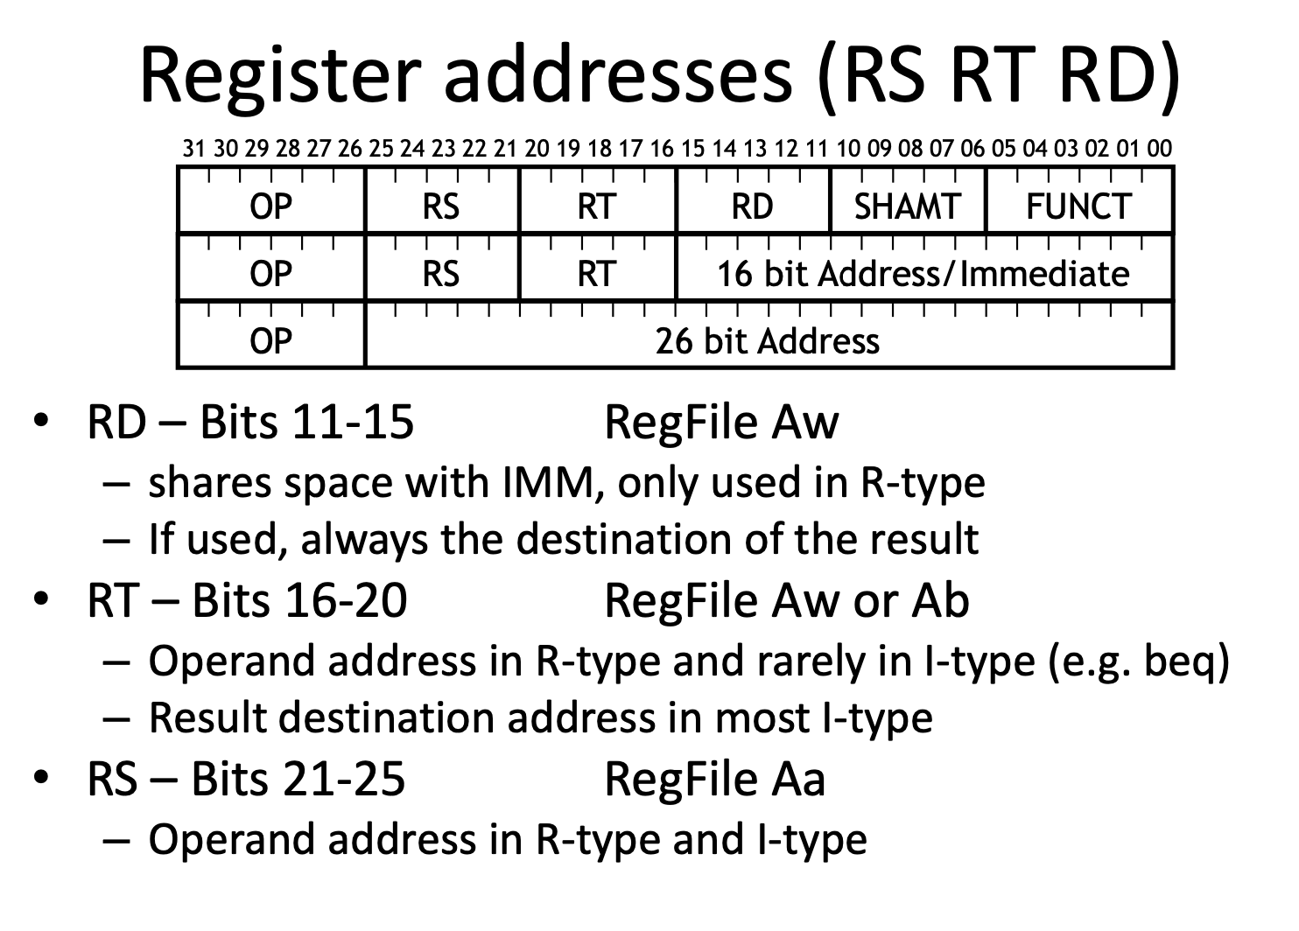

Slide 26
2. End
HOMEWORK ***
Collaborate on Slack
Laws of Boolean Algebra, Boolean Expressions, Truth Table
Complete practice problems
Download Logisim-evolution
Test that you are able to run on your computer.

